Slide 1
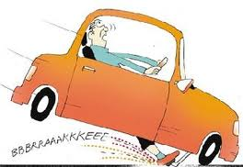
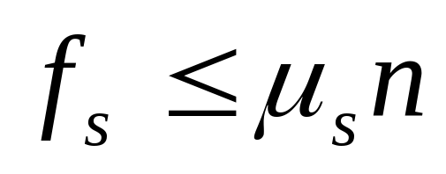
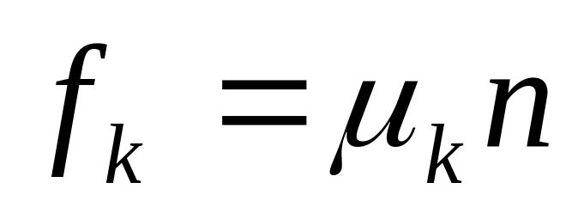
Forces and Friction
Physics 131
Lecture 7
Today:
Forces in equilibrium
Static and kinetic friction
All found in Young and Freedman, University Physics, chapter 4, section 1 to 6 and chapter 5, section 3 (just kinetic and static friction) and 4 (just horizontal motion)
Notes:
Today we are going to start looking at dynamics – the branch of mechanics concerned with forces that change the motion of bodies ie the cause of the motion.
Here’s a list of what you need to know from this lecture. You have this information on the handout I have given you. The handout also includes the text book references.

Slide 2
Newtons 3 laws
1. Things continue at same velocity
2. F=ma
3. Action-reaction

Slide 3


Slide 4
Problem solving strategy for equilibrium and non-equilibrium situations
Draw a free body diagram showing forces, and write out know and unknown quantities.
Choose an accelerating body and draw a free body diagram
Sum forces in the x and y directions.
For non-equilibrium instances – use F = ma

Slide 5
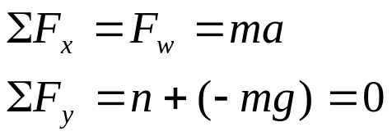
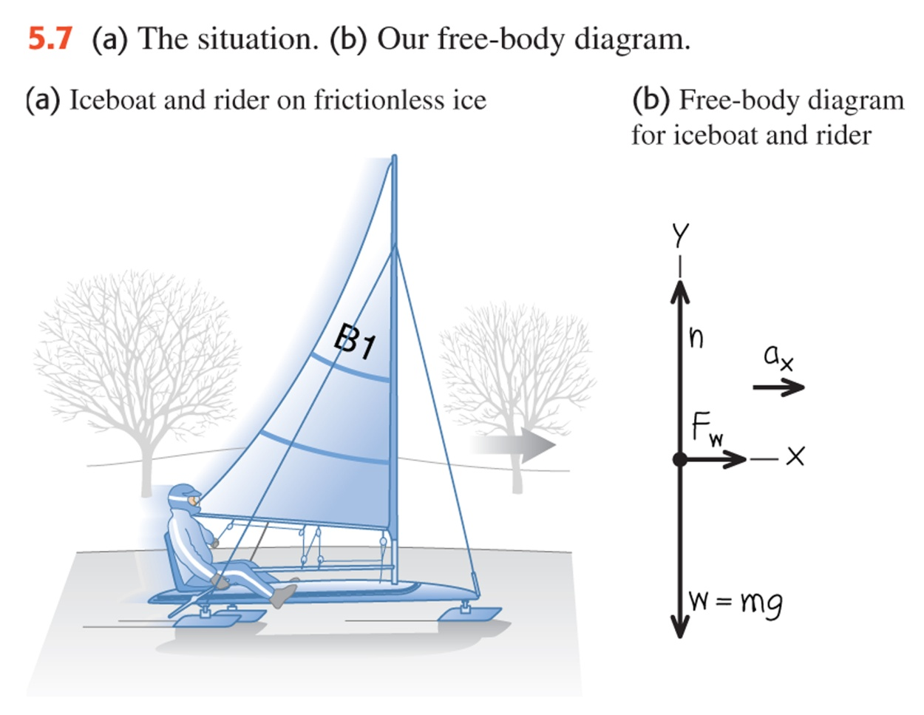
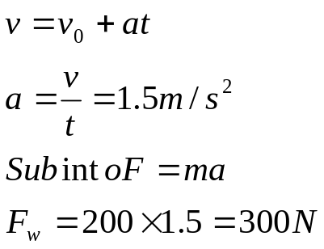
5.6 An iceboat is a rest on a perfectly frictionless horizontal surface. A wind is blowing along the direction of the runners so that 4 seconds after the iceboat is released it attains a velocity of 6.0 m/s. What constant horizontal force F_{w} does the wind exert on the iceboat? The mass of the iceboat and rider is 200 kg.

Slide 6
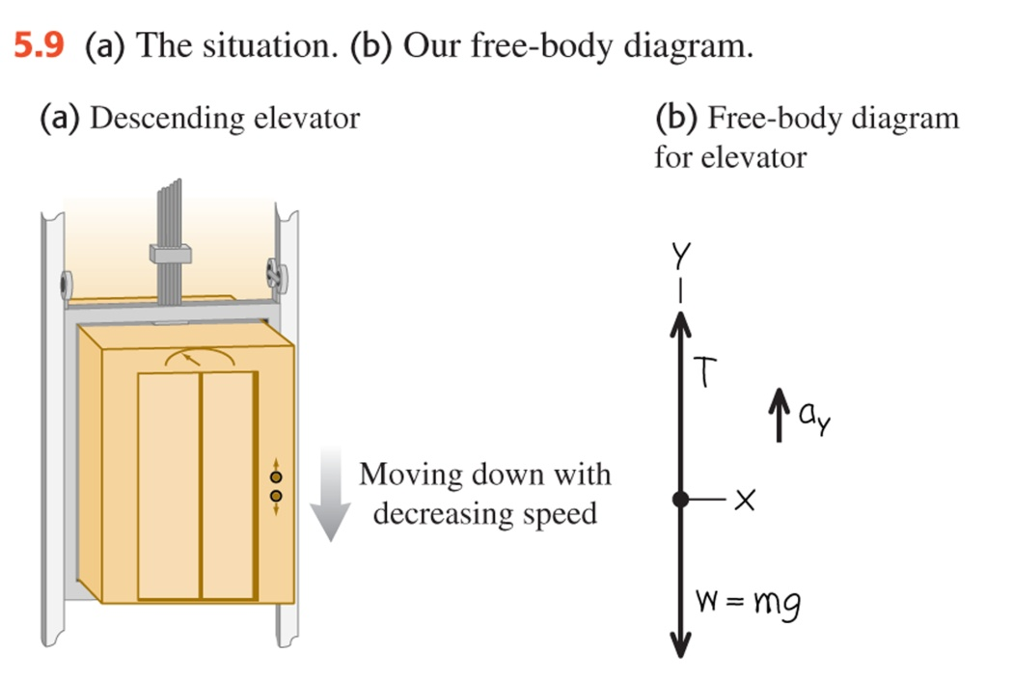
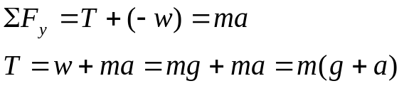
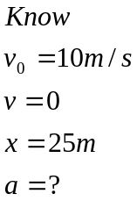
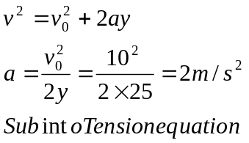
5.8 Tension in an elevator cable
An elevator and its load have total mass of 800kg. The elevator is originally moving downward at 10.0 m./s it slows to a stop with constant acceleration in a distance of 25.0 m. Find the tension T in the supporting cable while the elevator is being brought to rest.

Slide 7
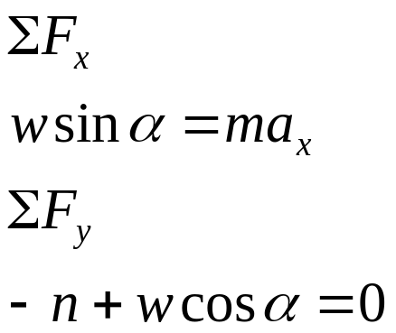
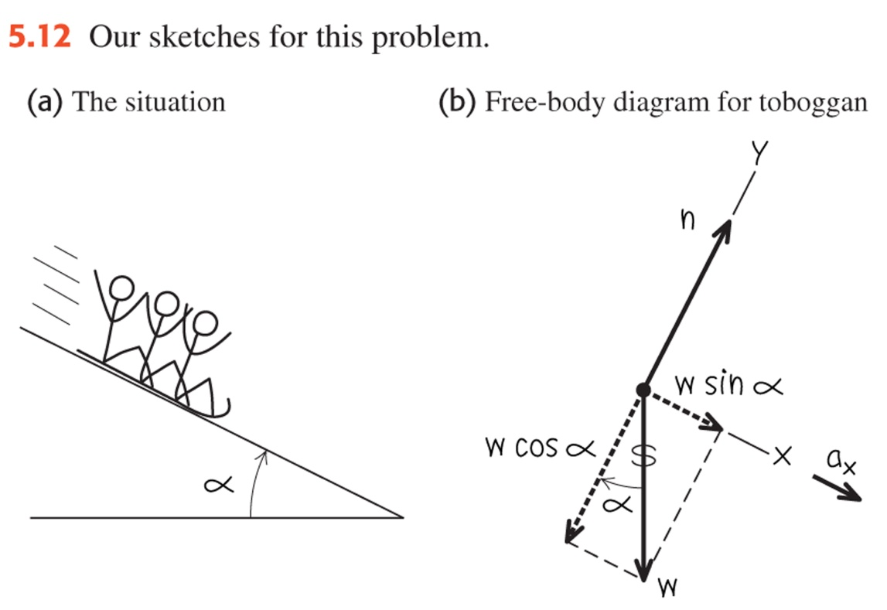
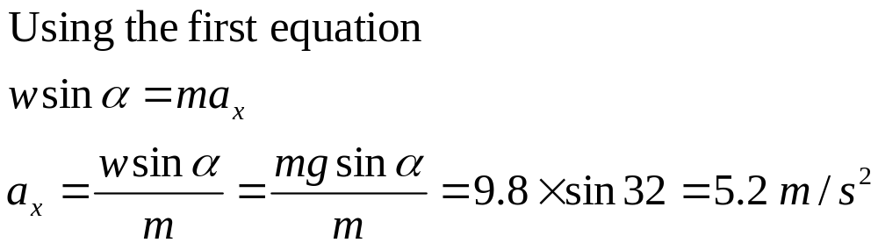
5.10 Acceleration down a hill
A toboggan loaded with holidaying students (total weight w) slides down a long, snow-covered slope. The hill slopes at a constant angle 32⁰ and the toboggan is well waxed that there is virtually no friction. What is its acceleration.
Draw a free body diagram

Slide 8
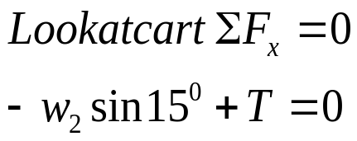
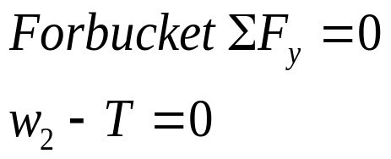
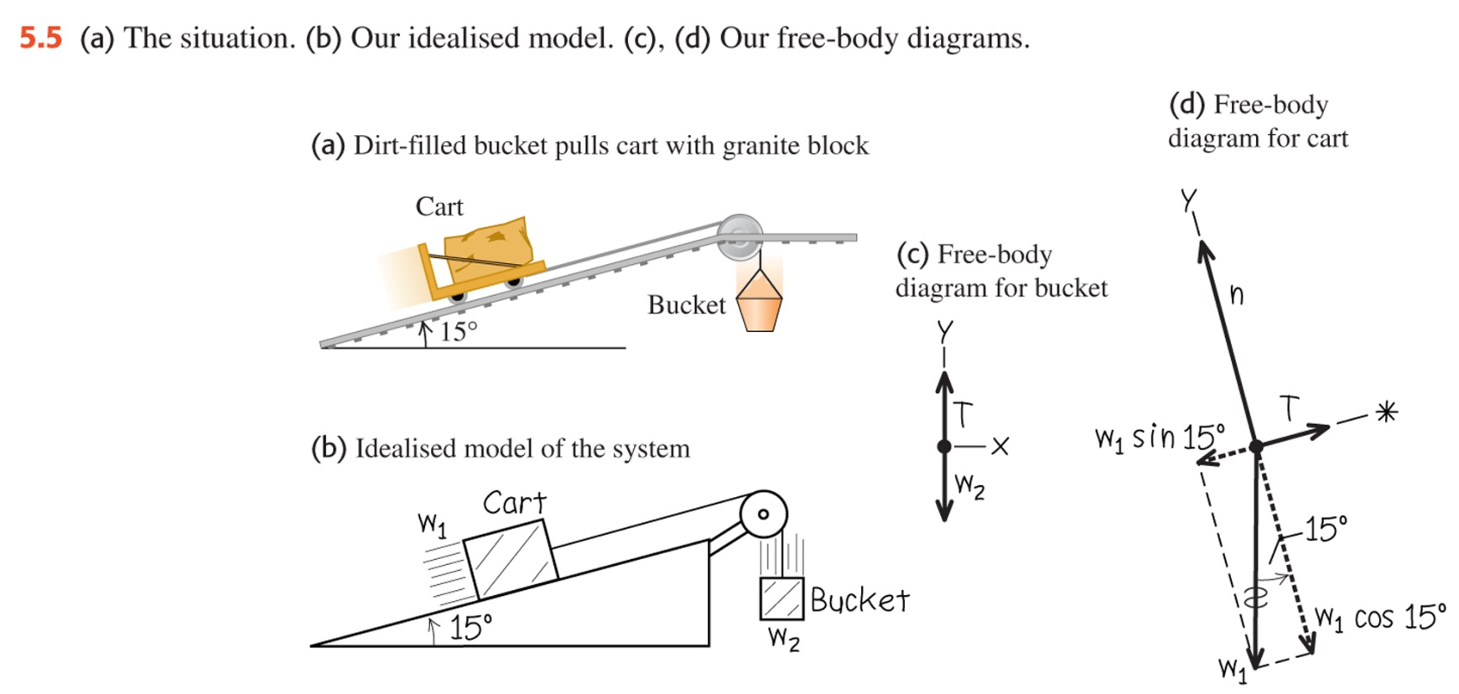
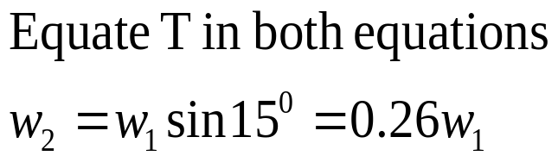
5.5 Blocks of granite are to be hauled up a 15⁰ slope out of a quarry and dirt is to be dumped into the quarry to fill up the old holes. To simplify the process, you design a system in which a granite block on a cart with steel wheels w₁(including both block and cart) is pulled uphill on steel rails by a dirt filled bucket weight w₂ (including both dirt and bucket) dropping vertically into the quarry. How must the weights w₁ and w₂ be related in order for the system to move with constant speed (assume no friction).

Slide 9
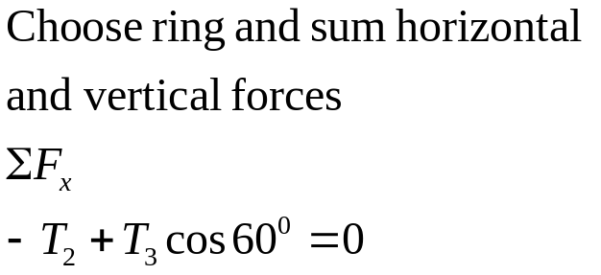
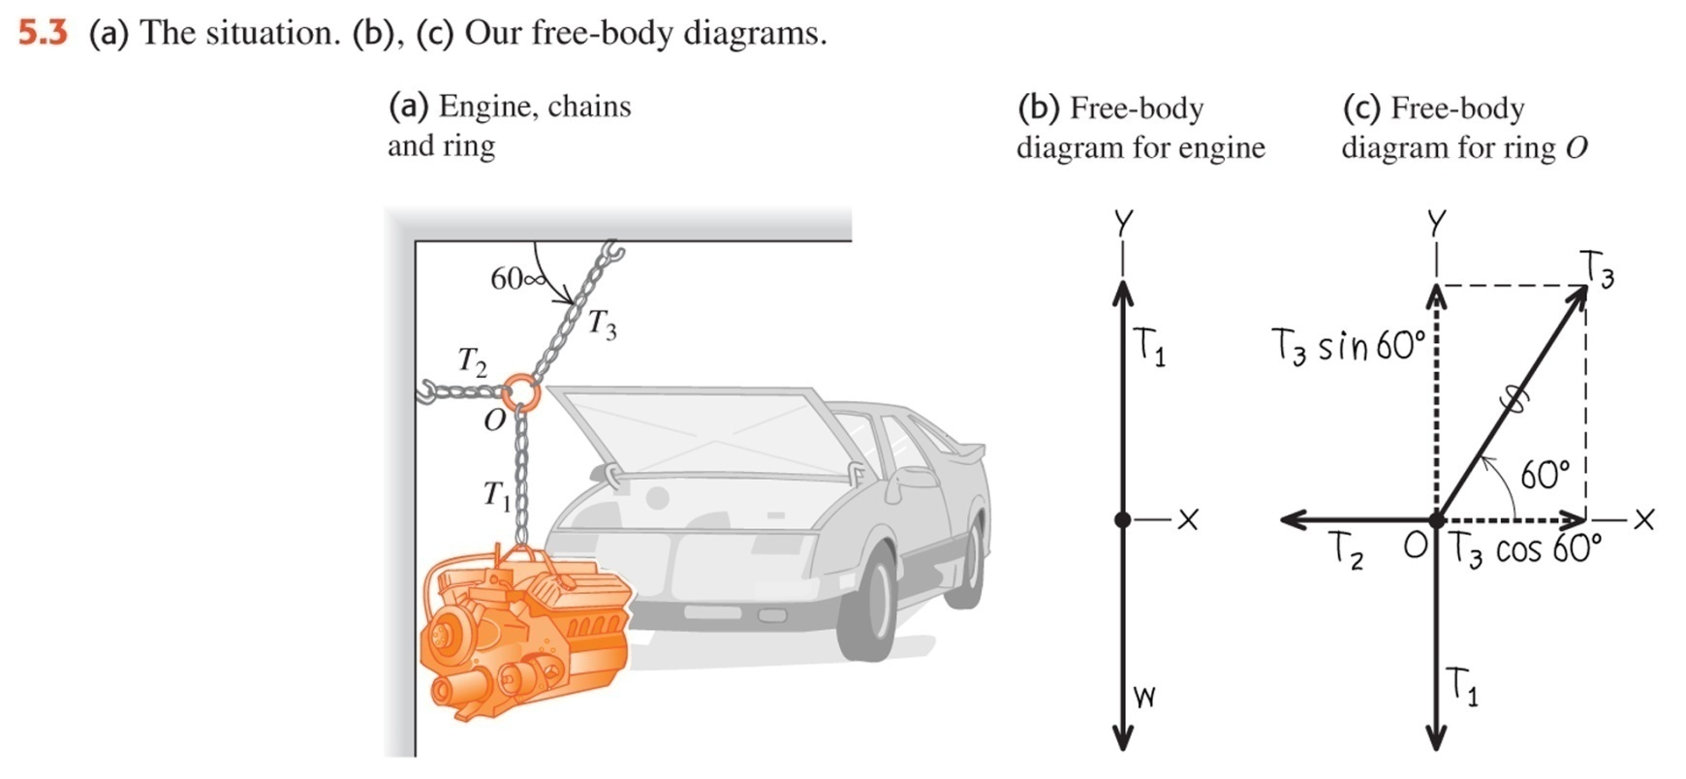
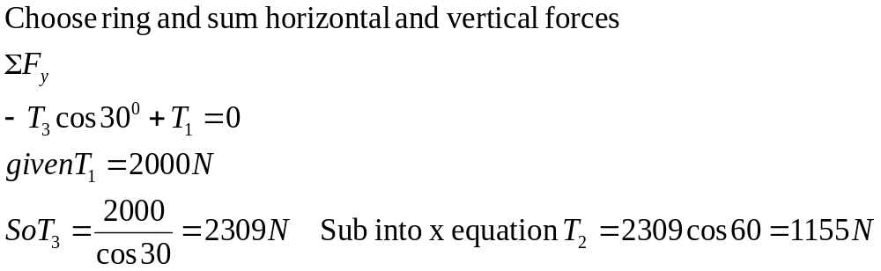
5.3 A car engine with a weight of 2000 N hangs from a chain that is linked at ring O to two other chains, one fastened to the ceiling and the other to the wall. Find the tension in each of the three chains.

Slide 10
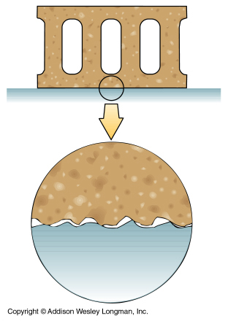
Static and kinetic friction
Frictional forces arise from interactions between molecules at high points on the surfaces of both the body and the surface
Notes:
So that’s looked at the laws and one force called weight. What about some other forces…we’ll start by looking at friction.
When a body is in contact with a surface and it is pushed, if the surface is what is known as frictional then the surface exerts a force on the body in such a way that impedes its motion. This diagram shows how it works. Frictional forces arise from interactions between molecules (usually electrical in nature) at high points on the surfaces of both the body and the surface. (Lubricants act to prevent the surfaces from coming into contact And so decreases the frictional force).
The frictional force acts parallel to the surface on which the object is placed and always acts to oppose the relative motion of the two surfaces. The other contact force that the surface applies to the body is the normal force. It is perpendicular to the surface. (DRAW)

Slide 11
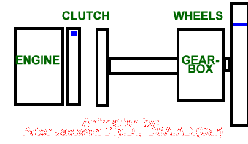
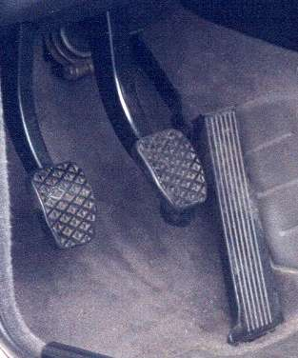
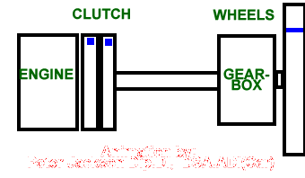
How does the clutch on a car work?
Disengaged
Engaged

Slide 12
Static friction- a force is needed to initially move an object, usually higher than once it is moving.
The static friction force can be written as
Where μ_{s} is a constant called the coefficient of static friction and n is the normal force
Notes:
What about when you’re pulling something and it still doesn’t actually move ? Is friction acting ? Yes. It acts to oppose the motion and it is not overcome until you pull with a force greater than the static friction force. It turns out that this static friction actually increases as you pull, until the force you pull with becomes greater than the maximum limit for the static friction force. The static friction force cannot exceed a certain value so once the pulling force exceeds this then the object will move (the bonds between the molecules of the object and the floor have been broken).
The static friction force has been experimentally measured to be proportional to the normal force (which in turn is related to the weight). This equation shows how to write the static friction force in terms of the normal force. The term mu s is called the coefficient of static friction. You can see that the static friction force can start at zero (when no force is applied, so since sum of forces must =0 then no frictional force or else would move) and get bigger and bigger until a certain point when the body slides and now kinetic friction comes into play.

Slide 13
Kinetic friction- a force is needed to keep the object moving
The kinetic friction force can be written as
Where μ_{k} is a constant called the coefficient of kinetic friction and n is the normal force
Notes:
You’re probably familiar with the frictional force that works as the object moves along. This is called the kinetic friction force. It has been experimentally measured to be proportional to the normal force (which in turn is related to the weight). This equation shows how to write the kinetic friction force in terms of the normal force. The term mu k is called the coefficient of kinetic friction.

Slide 14
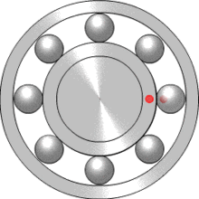
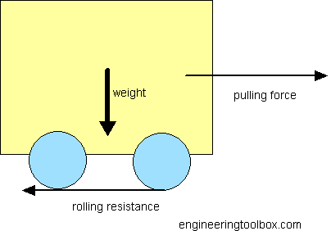
Coefficient of Rolling friction
Pushing a car still has friction even though the wheels are not slipping on the road.
For a normal car tyre on tar µ_{r} =0.03
For train wheels µ_{r}=0.0005
The rolling resistance of a normal car 1500 kg on asphalt with rolling friction (rolling coefficient from the table above) can be estimated like
F_{r} = 0.03 (1500 kg) (9.81 m/s²)
= 441 N

Slide 15
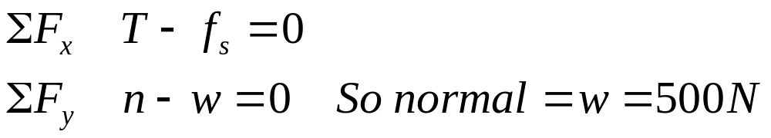
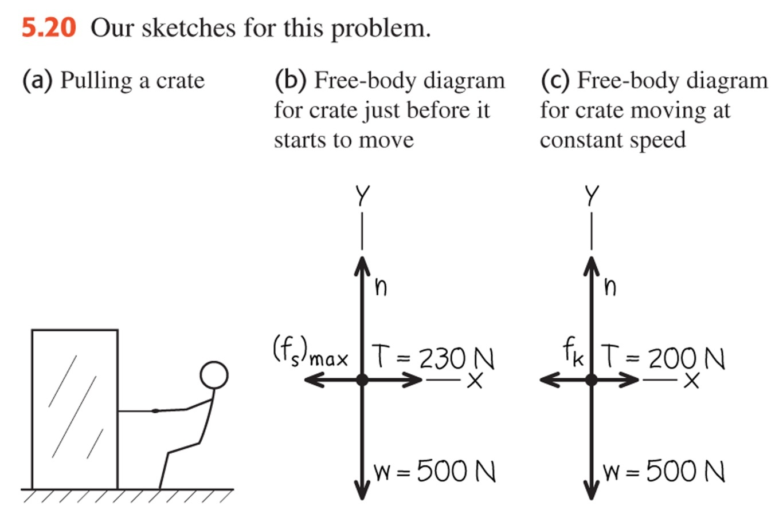
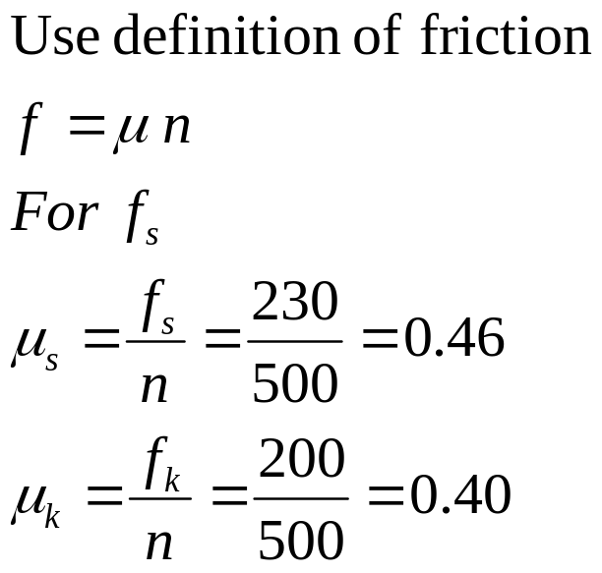
5.13 Friction in horizontal motion
You are trying to move a 500 N crate across a level floor. To start the crate moving, you have to pull it with a 230 N horizontal force. Once the crate “breaks loose” and starts to move, you can keep it moving at a constant velocity with only 200 N . What are the coefficients of static and kinetic friction?

Slide 16
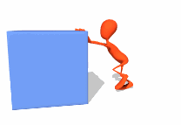
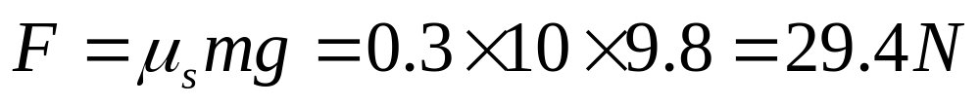
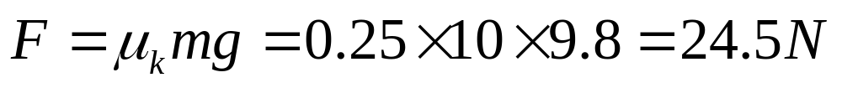
Example: Pushing box
What force is needed to push a box of mass 10kg if the coefficient of static friction is 0.3?
What force is needed once it begins to move if the coefficient of kinetic friction is 0.25?

Slide 17
Coefficients of Static µ_{s}, and Kinetic µ_{k} Friction
Materials | µ_{s} | µ_{k}
Steel on steel | 0.74 | 0.57
Copper on steel | 0.53 | 0.36
Glass on glass | 0.94 | 0.4
Teflon on steel | 0.04 | 0.04
Teflon on Teflon | 0.04 | 0.04
Rubber on concrete -dry | 1.0 | 0.8
Rubber on concrete -wet | 0.30 | 0.25
Notes:
Lets have a look at steel on steel- a good example of this is trains pulling into a station – they often skid coming into stations…
The copper on steel is probably the reason train wheels on trains are steel..not copper
Glass on glass is quite interesting- they seem to stick together… then suddenly give…
Teflon is the super coating- that is very stippery…. Seen on frying pans… also teflon tape- for waterproofing things- so that threads tighten togeter…
Rubber on concrete- is very high…. Which explains why tires are good on roads..

Slide 18
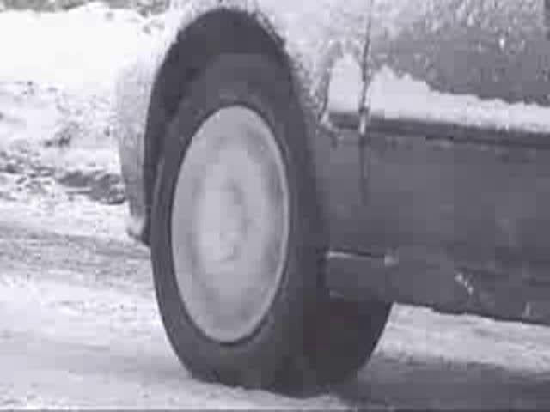
Coefficient between rubber and ice low

Slide 19
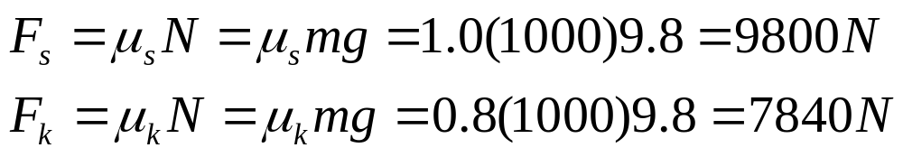
Force towing a car
A truck is pulling a 1000 kg car with all brakes on.
What force will be needed to make the car begin to move, if the road is concrete? µ_{s}=1.00 µ_{k}=0.8
What force is needed to keep the car moving?

Slide 20
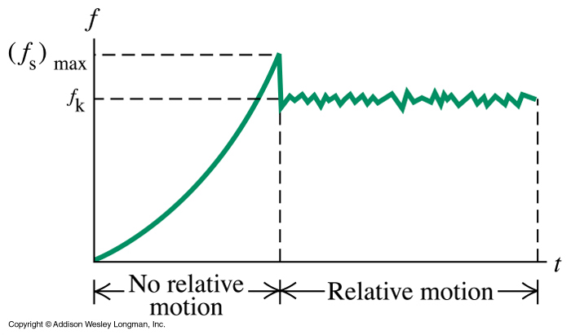
Static and kinetic friction – force needed to move an object
Notes:
This graph shows you what’s happening.
We start with a body at rest with no horizontal force acting on it (there is of course weight acting downwards and the normal force acting upwards).
The sum of the forces is zero and so no motion. Then you apply a force to pull the object along but the object doesn’t move. The static friction force opposes your pulling force and as you pull harder it increases. Since there is no motion then the sum of the forces must be zero and so your pulling force must equal the static friction force. See this in the bit where there is no relative motion. Once the static friction force reaches its maximum, the bonds between the surfaces break and the body is free to move. Your force can remain the same but now the bonds have been broken and the object is free to move. So kinetic friction comes into play. This has a lower value than the static friction and so your force is greater than it, we have a non equilibrium situation where there is a resultant force and so the object accelerates as it goes from zero velocity to some value. You tend to stop pulling so hard and let your pulling force equal the kinetic friction force so that the body moves along at a constant velocity.

